Slide 1

ABC Pharma – Drug Persistence
Name: Yusuf Aishat
Email: aishatyusuf12@gmail.com
Country: Nigeria
Specialization: Data Science
November 15th, 2024

Slide 2

Agenda
Executive Summary
Problem Statement
Approach
EDA
Recommendations
Proposed models

Slide 3
Executive Summary
Objective
To gather insights on the factors that are impacting persistency, automate the identification of persistent patients and give recommendations to improve persistency rates.
Key findings:
Demographics: Patients of Asian origin and those in the Western region show high persistence rates
Clinical Factors: Persistence is higher among patients who had DEXA scans, glucocorticoid use and fragility fractures during treatment
Specialist Care: Patients seen by specialists, particularly endocrinologists, oncologists and urologists show higher persistence rates
Adherence: Surprisingly, Non-adherent patients show higher rate of persistence, with factors like screenings for malignancy, immunization, and DEXA scans common in persistent cases.
Patients that are persistent with their treatment tend to have multiple comorbidities, concomitances and risks
Recommendations:
Increase screenings and regular check-ups to boost persistence rates
Integrate more patients into IDNs to improve persistence
Educate patients, especially low-risk patients, to encourage treatment adherence and persistence
Enhance collaborations among healthcare providers to share strategies for improving persistence
Conduct further research to address the low persistence rates among certain demographics

Slide 4
Problem Statement
Drug persistence is vital for an effective course of treatment, yet many patients fail to stay persistent with their treatment for various reasons. This lack of persistence can lead to poorer health outcomes, higher health care costs and increased burden on healthcare system.
The company, ABC Pharma, wants to automate the identification of drug persistence as per the physician's prescription. The goal is to build a classification model to predict whether a patient will persist with their treatment and to identify the factors that influence drug persistence.

Slide 5
Approach
The dataset provided tracks patient persistence with their NTM (Non-Tuberculous Mycobacterial Disease) treatment. The dataset contains 3424 records and 69 attributes, each representing patients of various demographics, attributes of their health care provider, clinical factors, disease, and treatment factors.
The dataset was then cleaned by removing columns with high proportions of missing values and handling specific entry errors. Following this, Exploratory Data Analysis was carried out to extract insights about factors affecting persistence.

Slide 6
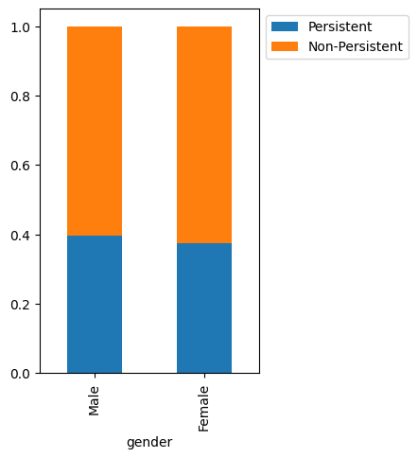
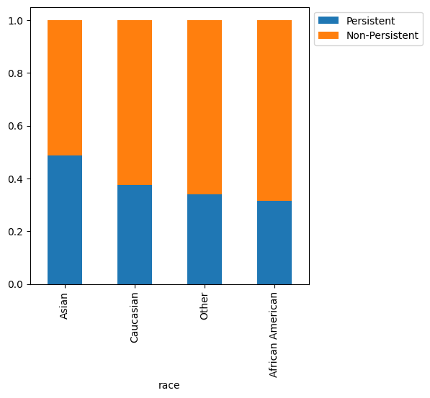
Patient demographics
Male patients have a slightly higher rate of persistence
Asian patients have the highest persistence rate of 48.81% when compared to other groups
African American patients have the lowest persistence rate of 31.58%

Slide 7
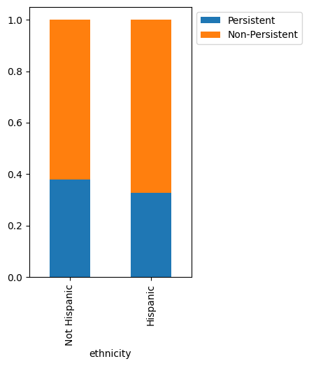
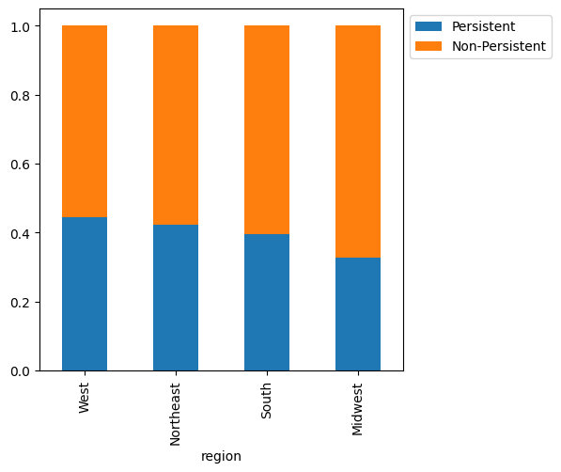
Patient demographics
Non-Hispanic patients have a higher persistence rate of 37.79% compared to Hispanic patients with 32.65%
Patients in the Western region show a higher persistence rate of 44.42%, while those in the Midwest have the lowest persistence rate of 32.85%

Slide 8
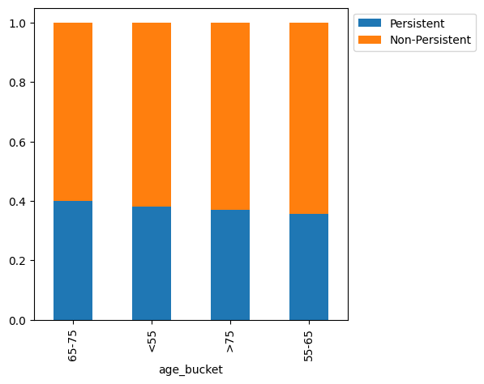
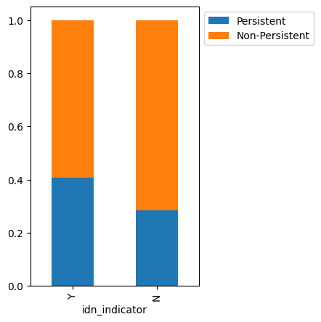
Patient demographics
The difference in the persistent rate among the different age groups isn’t so pronounced and the age group with the highest persistence rate is those aged 65-75 with 39.87%
Patients mapped to an IDN have a much higher persistent rate (40.79%) than those who are not.

Slide 9
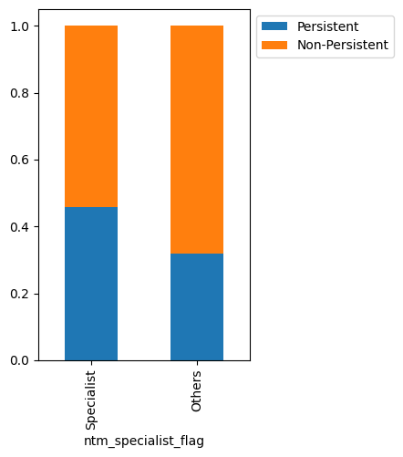
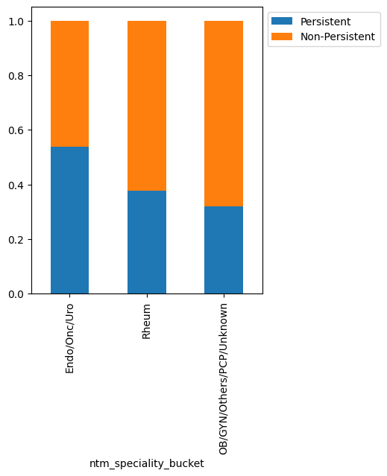
Provider Attributes
* NTM Specialist Flag: Patients seen by a specialist have a higher persistence rate at 45.71%
* NTM Specialist Bucket: Patients treated by Endocrinologists/Oncologists/Urologist have a higher persistence rate at 53.91%

Slide 10
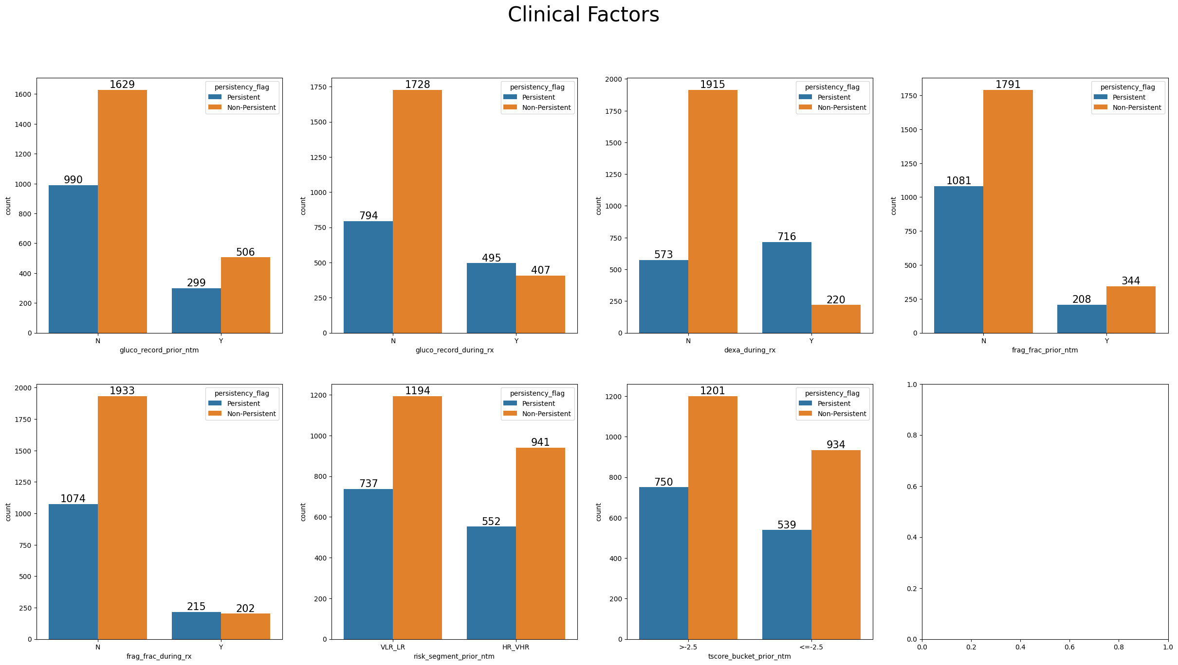
Clinical factors
Patients who had recorded glucocorticoid usage during therapy, DEXA scans during treatment and fragility fracture during therapy had a higher rate of persistence

Slide 11
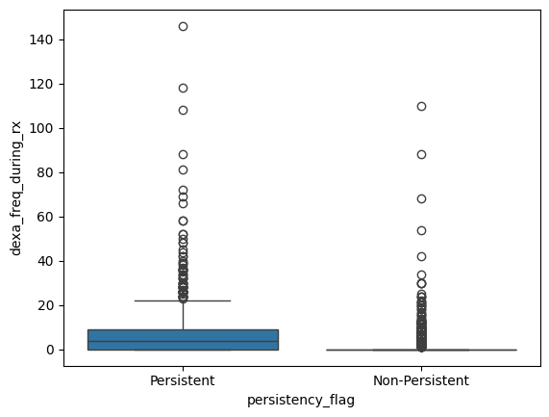
Clinical factors
Patients persistent with their treatment on average have higher frequencies of dexa scans

Slide 12
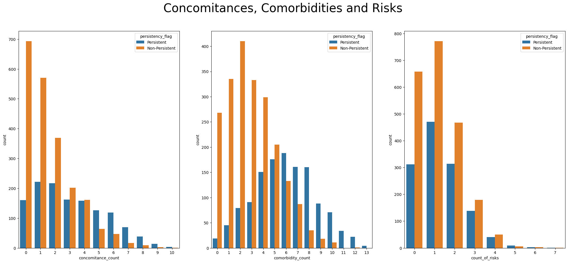
Disease and Treatment Factors
There is higher rate of persistence among patients with ≥5 concomitances, comorbidities and risks.
Patients that are Persistent with their treatment are more likely to have multiple concomitances, comorbidities and risks

Slide 13
Disease and Treatment Factors
Comorbidities: Patients with comorbidities tend to have higher persistence rates except for those with lipoprotein metabolism and other lipidemias or osteoporosis without current pathological fracture.
Concomitances: Patients with concomitances involving cholesterol and triglyceride regulating preparations or antidepressants and mood stabilizers show lower persistence rates
Risks: Patients with risks tend to show lower persistence rates except for those with rheumatoid arthritis or untreated chronic hypogonadism

Slide 14
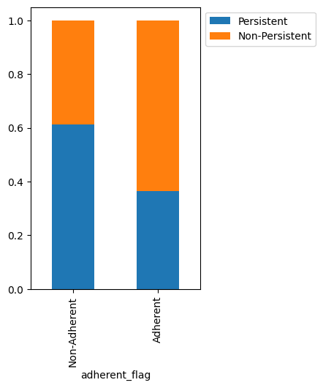
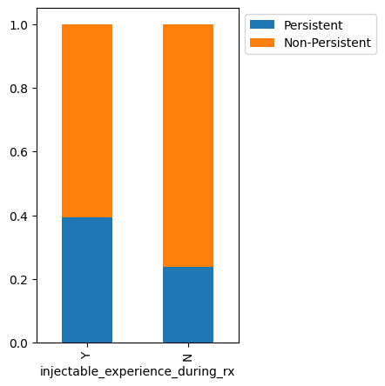
Disease and Treatment Factors
Patients with injectable experience during treatment have a higher rate of persistence at 39.30%
The percentage of Persistent patients is higher among the Non-Adherent patients (61.27%) compared to Adherent patients (36.39%)

Slide 15
Disease and Treatment Factors
Adherence
The persistence of non-adherent patients is much higher (61.27%) compared to adherent patients (36.38%). This is peculiar, as one might expect an adherent patient to be more persistent with their treatment. Upon further analysis, some factors were found to be prevalent among non-adherent and adherent groups who maintain drug persistency. These factors include:
* Presence of DEXA scans during treatment
* Comorbidity screening for malignant neoplasms
* Comorbidity encounter for immunization
* General exam without complaints, suspected or reported diagnosis
* Disorders of lipoprotein metabolism and other lipidemias
* Risk of vitamin D insufficiency

Slide 16
Recommendations
Increased screenings, preventive exams and improved monitoring of patients through more regular check ups would facilitate an increase in persistence rates
Patients with an IDN indicator have higher rates of persistence; integrating more patients into this network would surely improve persistence
Patients with low risks, comorbidities, and concomitances are more likely to be non-persistent because they may not feel the need to be persistent with their treatment. Patient education would help improve persistency.
Enhancing collaboration among healthcare providers so they can share methods and strategies that help improve persistence.
Further studies can be conducted to figure out why certain demographic groups have lower drug persistence and results from these studies can help create targeted interventions to help increase the persistence in these groups

Slide 17
Proposed models
The models to be tested for prediction include Logistic Regression, Decision Trees, Random Forest, Bagging, and Boosting algorithms.
The final model will be selected based on accuracy, prediction, recall, and interpretability, enabling the identification of key factors influencing persistence.
This will ensure the model is reliable in its predictions and informative in revealing insights for improving patient persistence.

Slide 18
Thank You

